Slide 1
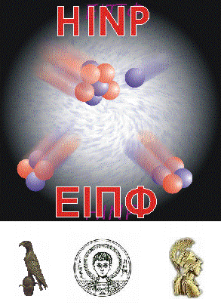
5th Hellenic Institute of Nuclear Physics Workshop (HINPw5)
April 12-13, 2019
Department of Physics ▪ Aristotle University of Thessaloniki
Photo album

Slide 2
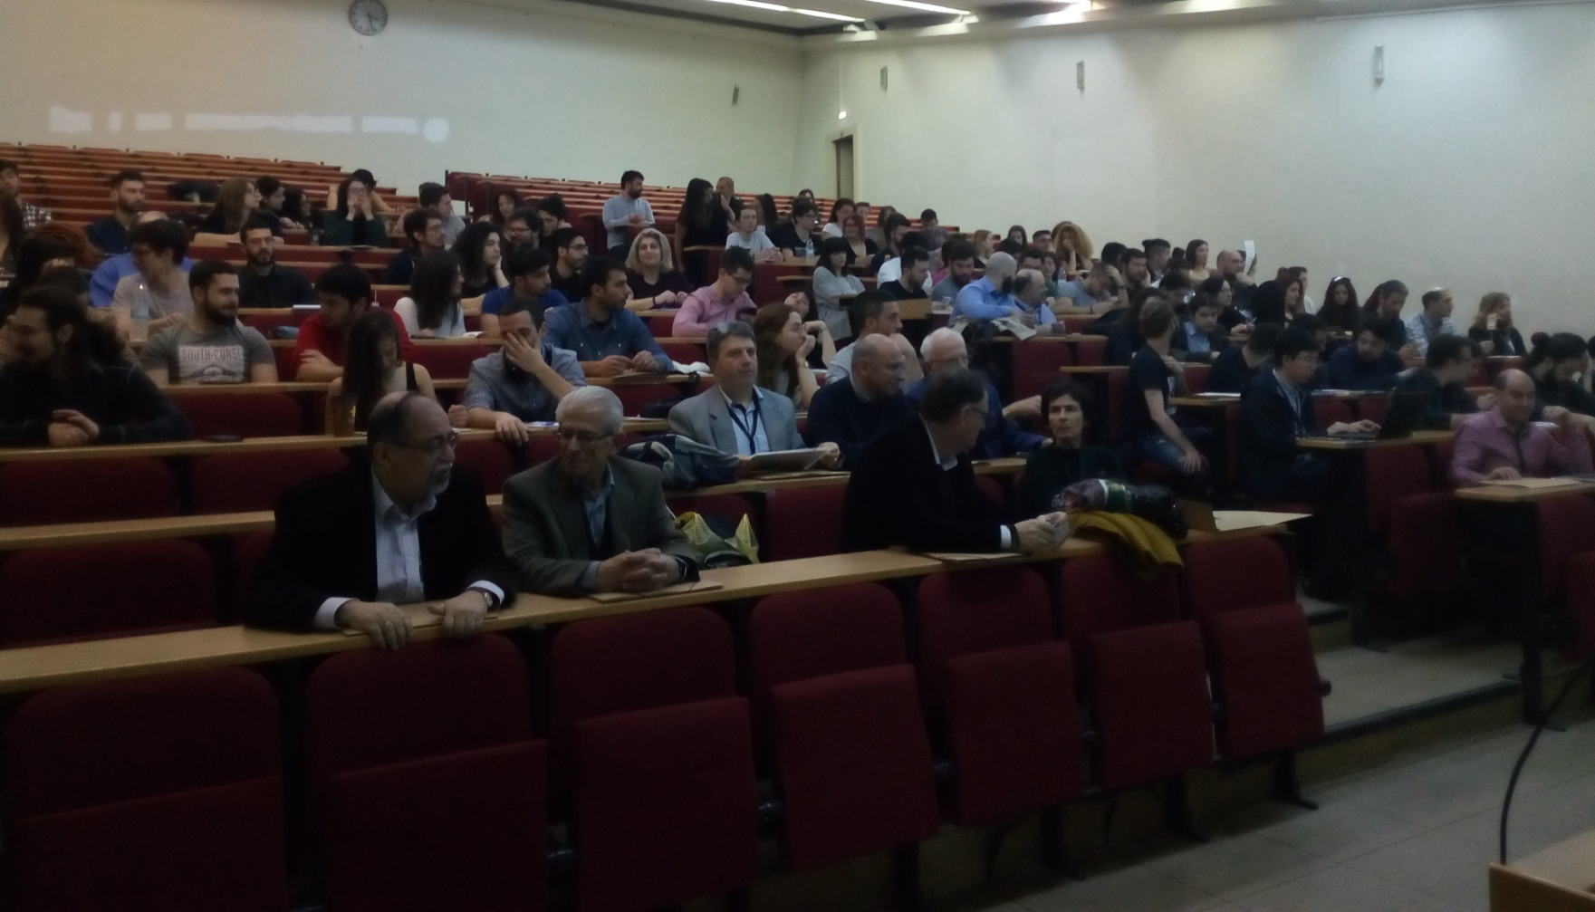
5th Hellenic Institute of Nuclear Physics Workshop (HINPw5)
April 12-13, 2019 - Physics Department, Aristotle University of Thessaloniki

Slide 3
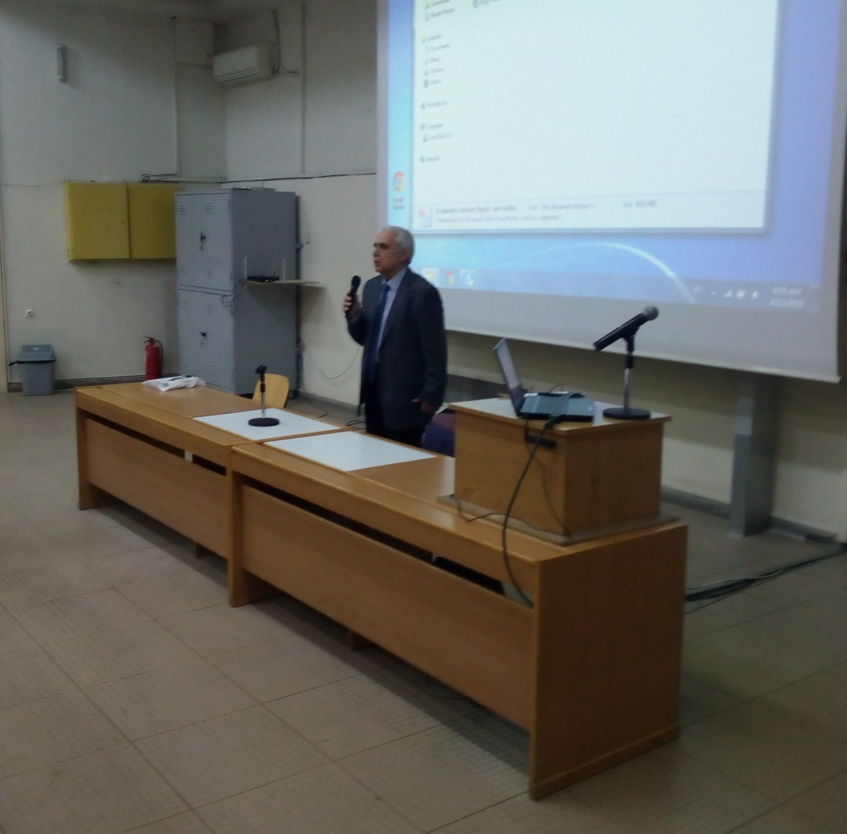
5th Hellenic Institute of Nuclear Physics Workshop (HINPw5)
April 12-13, 2019 - Physics Department, Aristotle University of Thessaloniki

Slide 4
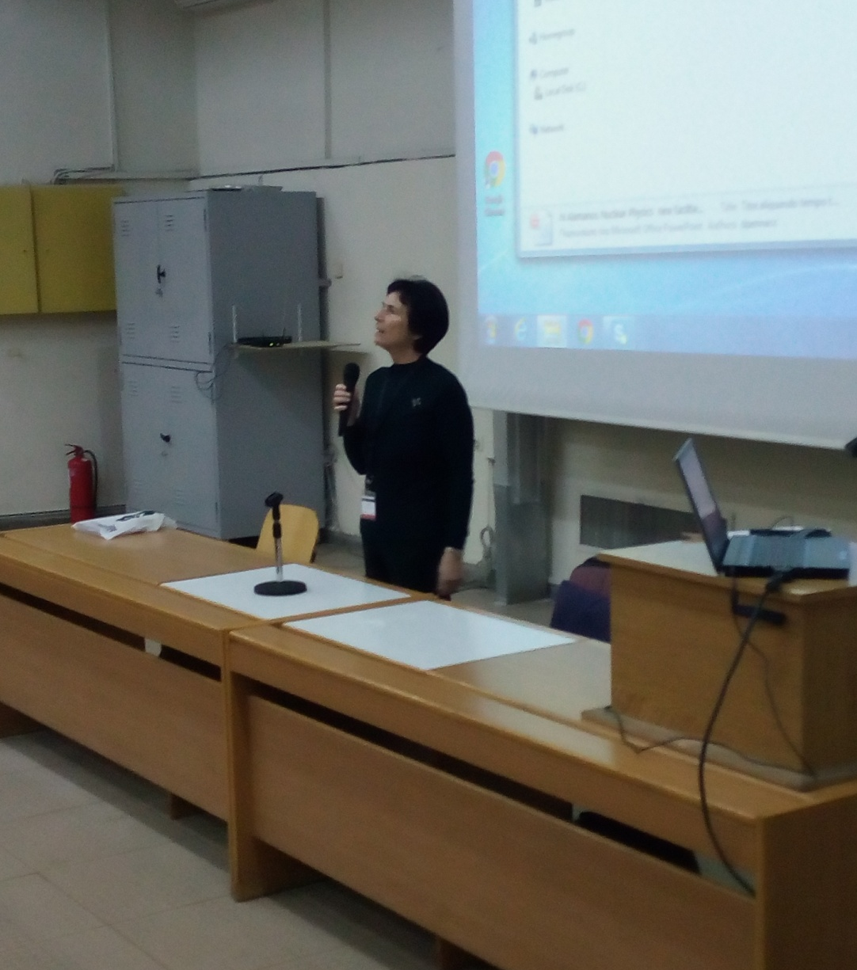
5th Hellenic Institute of Nuclear Physics Workshop (HINPw5)
April 12-13, 2019 - Physics Department, Aristotle University of Thessaloniki

Slide 5
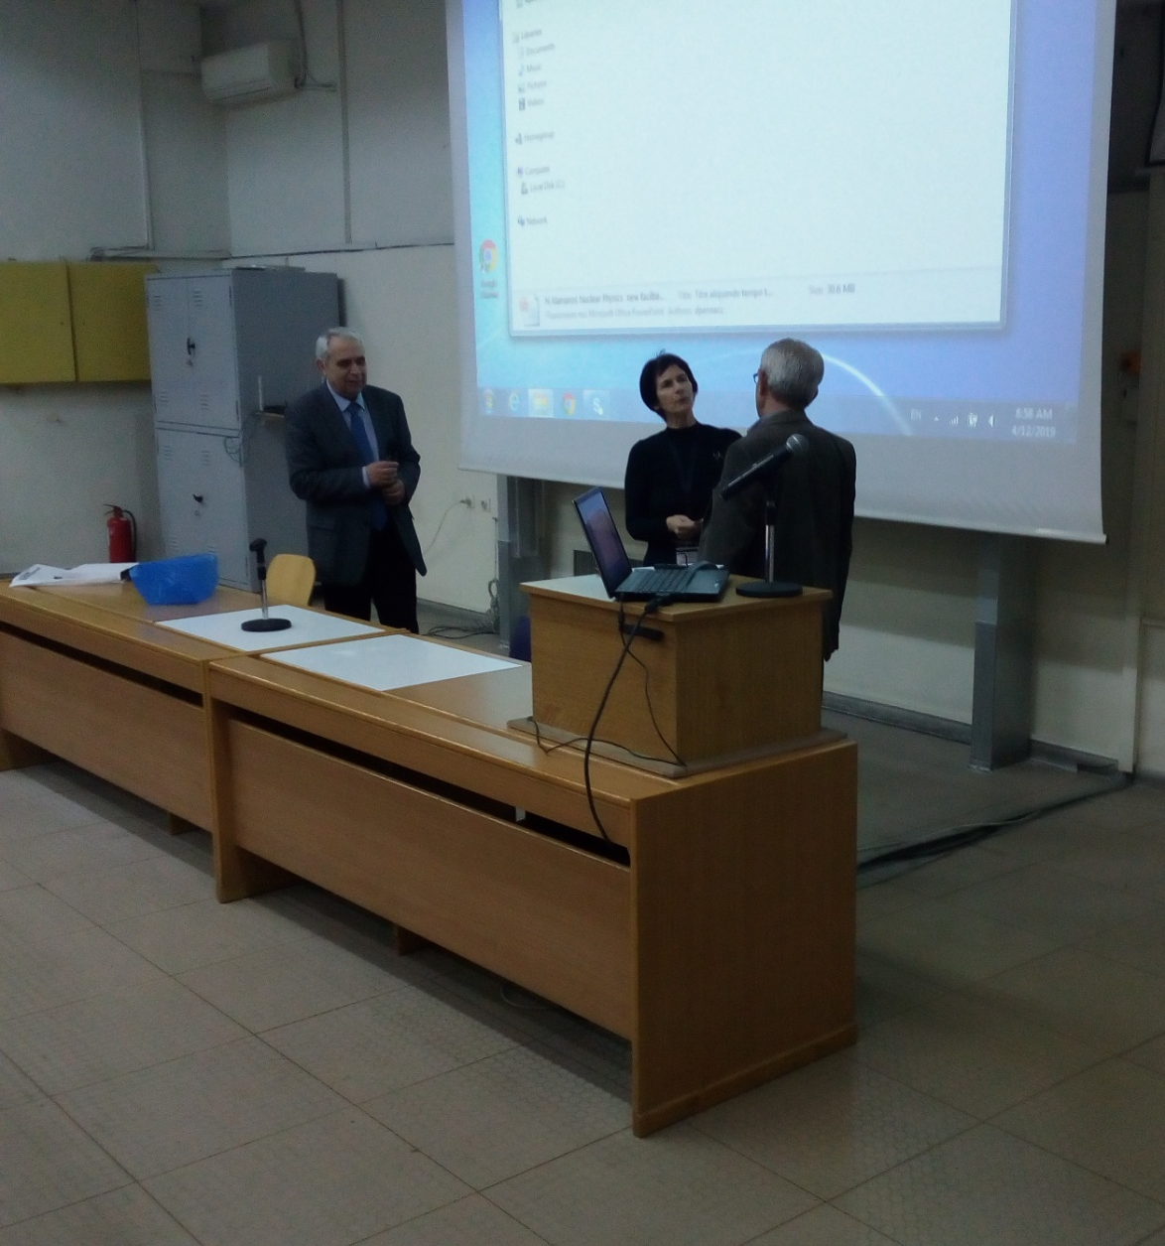
5th Hellenic Institute of Nuclear Physics Workshop (HINPw5)
April 12-13, 2019 - Physics Department, Aristotle University of Thessaloniki

Slide 6
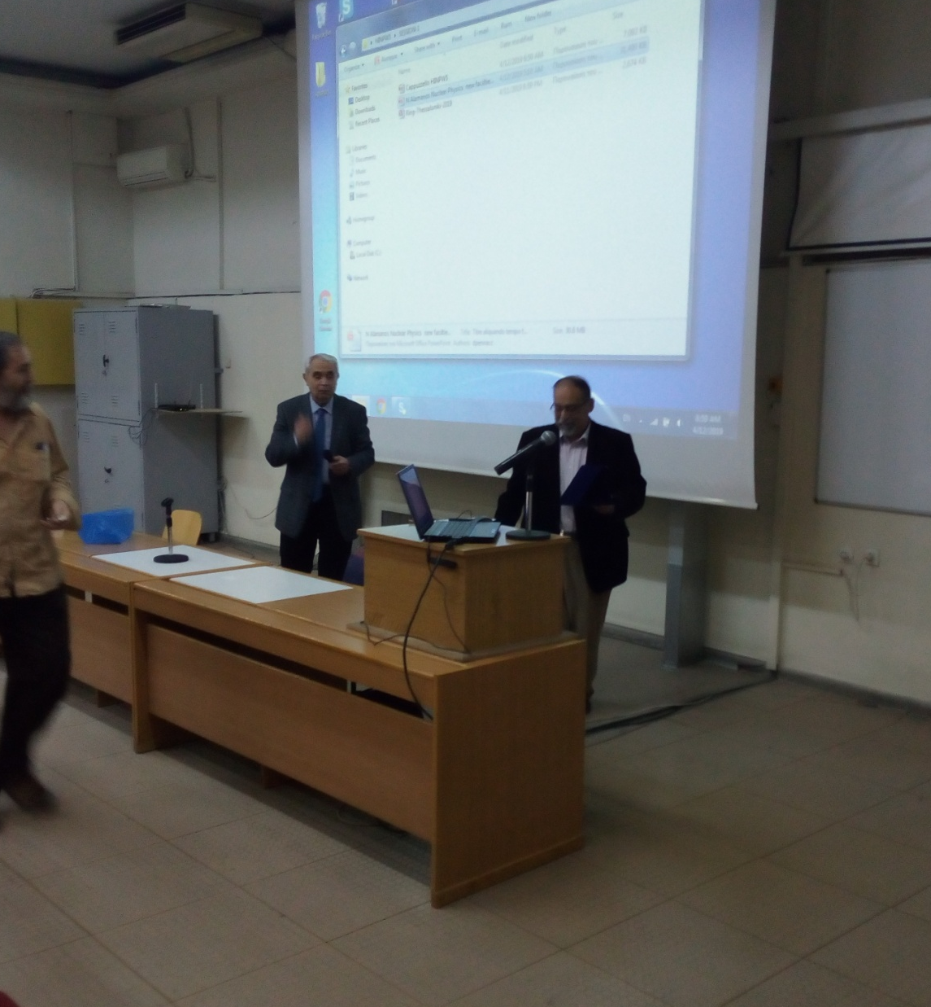
5th Hellenic Institute of Nuclear Physics Workshop (HINPw5)
April 12-13, 2019 - Physics Department, Aristotle University of Thessaloniki

Slide 7
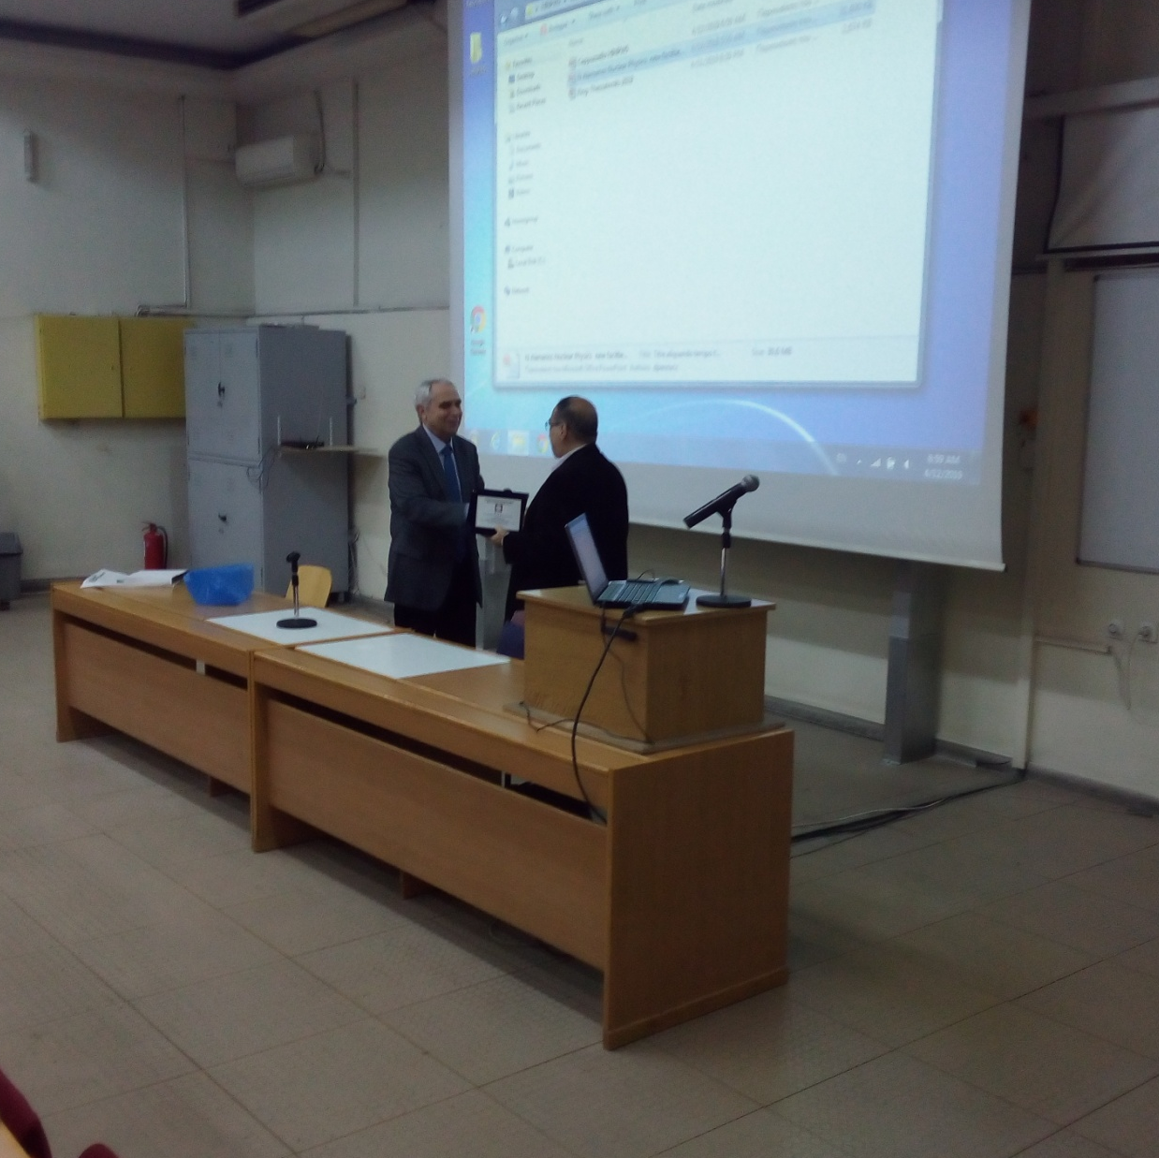
5th Hellenic Institute of Nuclear Physics Workshop (HINPw5)
April 12-13, 2019 - Physics Department, Aristotle University of Thessaloniki

Slide 8
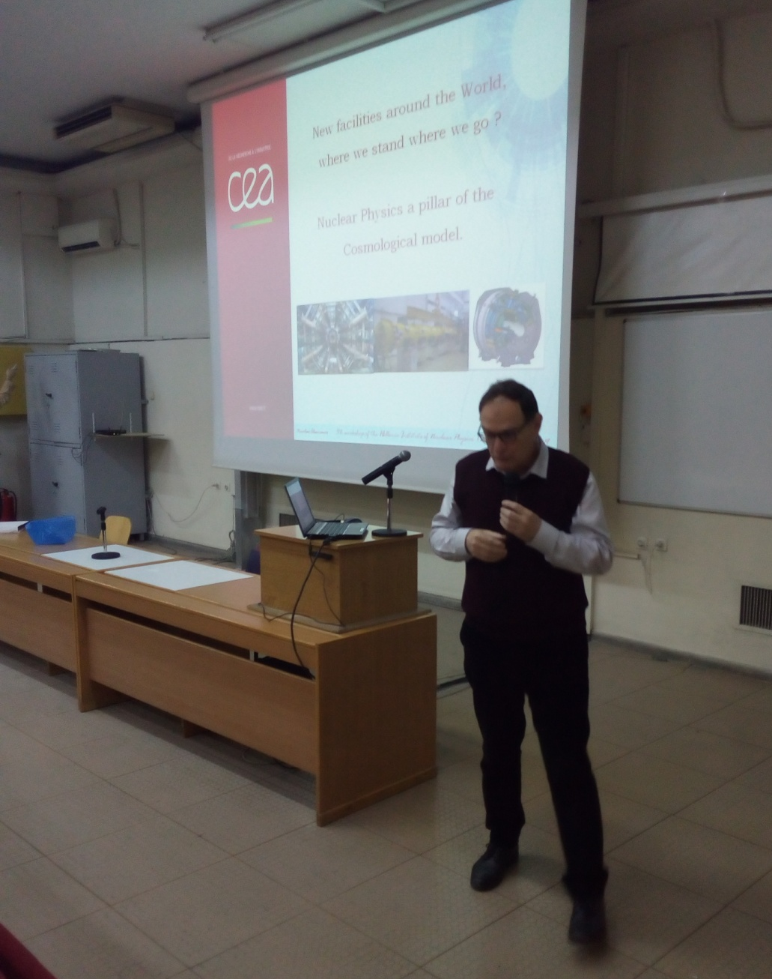
5th Hellenic Institute of Nuclear Physics Workshop (HINPw5)
April 12-13, 2019 - Physics Department, Aristotle University of Thessaloniki

Slide 9
5th Hellenic Institute of Nuclear Physics Workshop (HINPw5)
April 12-13, 2019 - Physics Department, Aristotle University of Thessaloniki

Slide 10
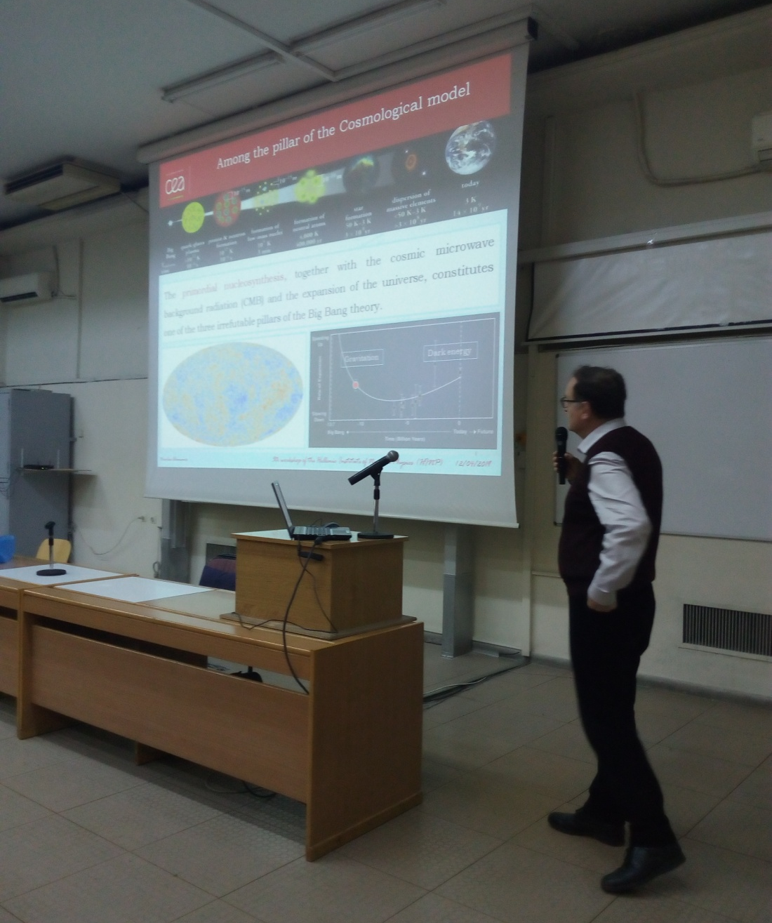
5th Hellenic Institute of Nuclear Physics Workshop (HINPw5)
April 12-13, 2019 - Physics Department, Aristotle University of Thessaloniki

Slide 11
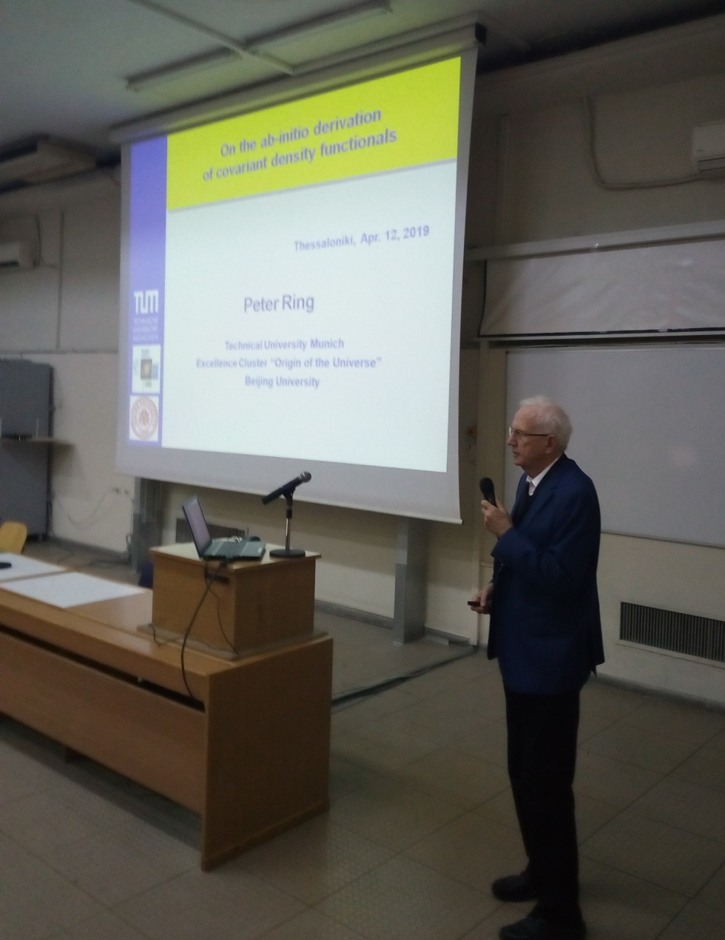
5th Hellenic Institute of Nuclear Physics Workshop (HINPw5)
April 12-13, 2019 - Physics Department, Aristotle University of Thessaloniki

Slide 12
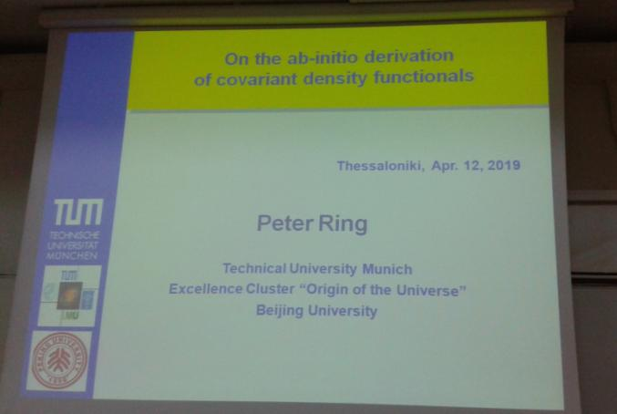
5th Hellenic Institute of Nuclear Physics Workshop (HINPw5)
April 12-13, 2019 - Physics Department, Aristotle University of Thessaloniki

Slide 13
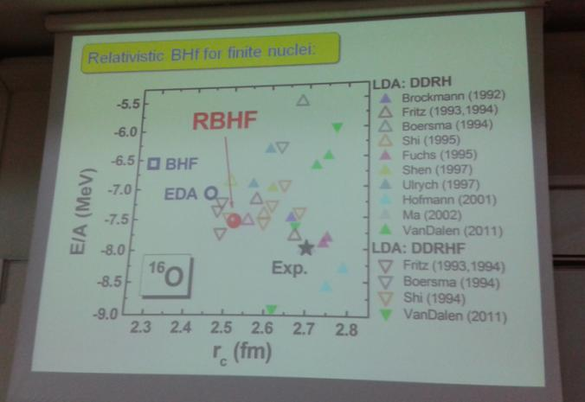
5th Hellenic Institute of Nuclear Physics Workshop (HINPw5)
April 12-13, 2019 - Physics Department, Aristotle University of Thessaloniki

Slide 14
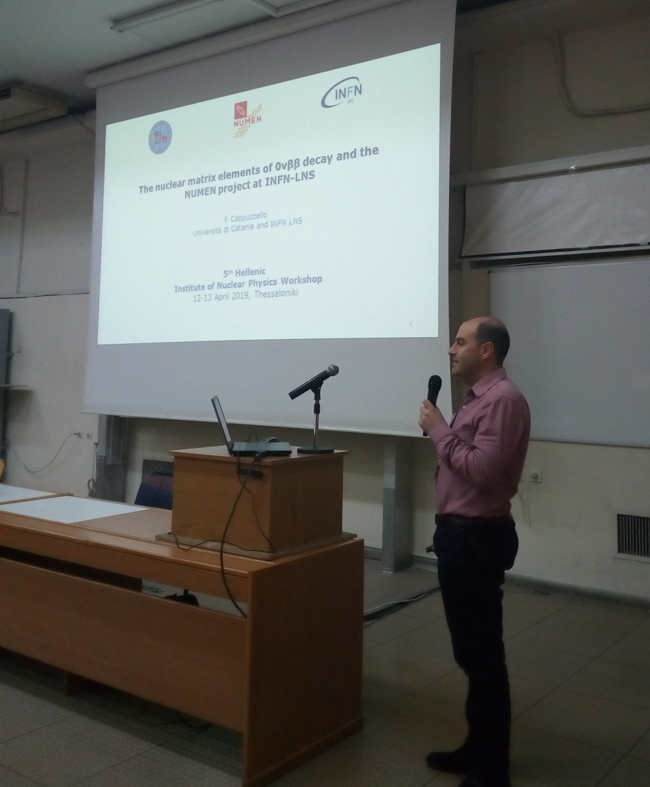
5th Hellenic Institute of Nuclear Physics Workshop (HINPw5)
April 12-13, 2019 - Physics Department, Aristotle University of Thessaloniki

Slide 15
5th Hellenic Institute of Nuclear Physics Workshop (HINPw5)
April 12-13, 2019 - Physics Department, Aristotle University of Thessaloniki

Slide 16
5th Hellenic Institute of Nuclear Physics Workshop (HINPw5)
April 12-13, 2019 - Physics Department, Aristotle University of Thessaloniki

Slide 17
5th Hellenic Institute of Nuclear Physics Workshop (HINPw5)
April 12-13, 2019 - Physics Department, Aristotle University of Thessaloniki

Slide 18
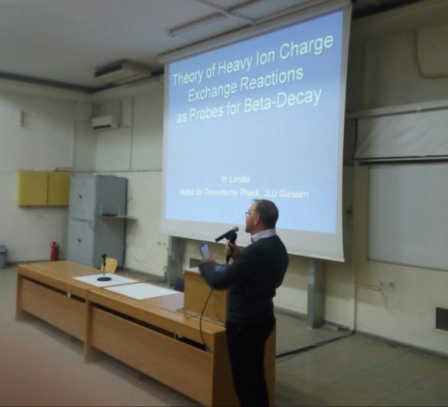
5th Hellenic Institute of Nuclear Physics Workshop (HINPw5)
April 12-13, 2019 - Physics Department, Aristotle University of Thessaloniki

Slide 19
5th Hellenic Institute of Nuclear Physics Workshop (HINPw5)
April 12-13, 2019 - Physics Department, Aristotle University of Thessaloniki

Slide 20
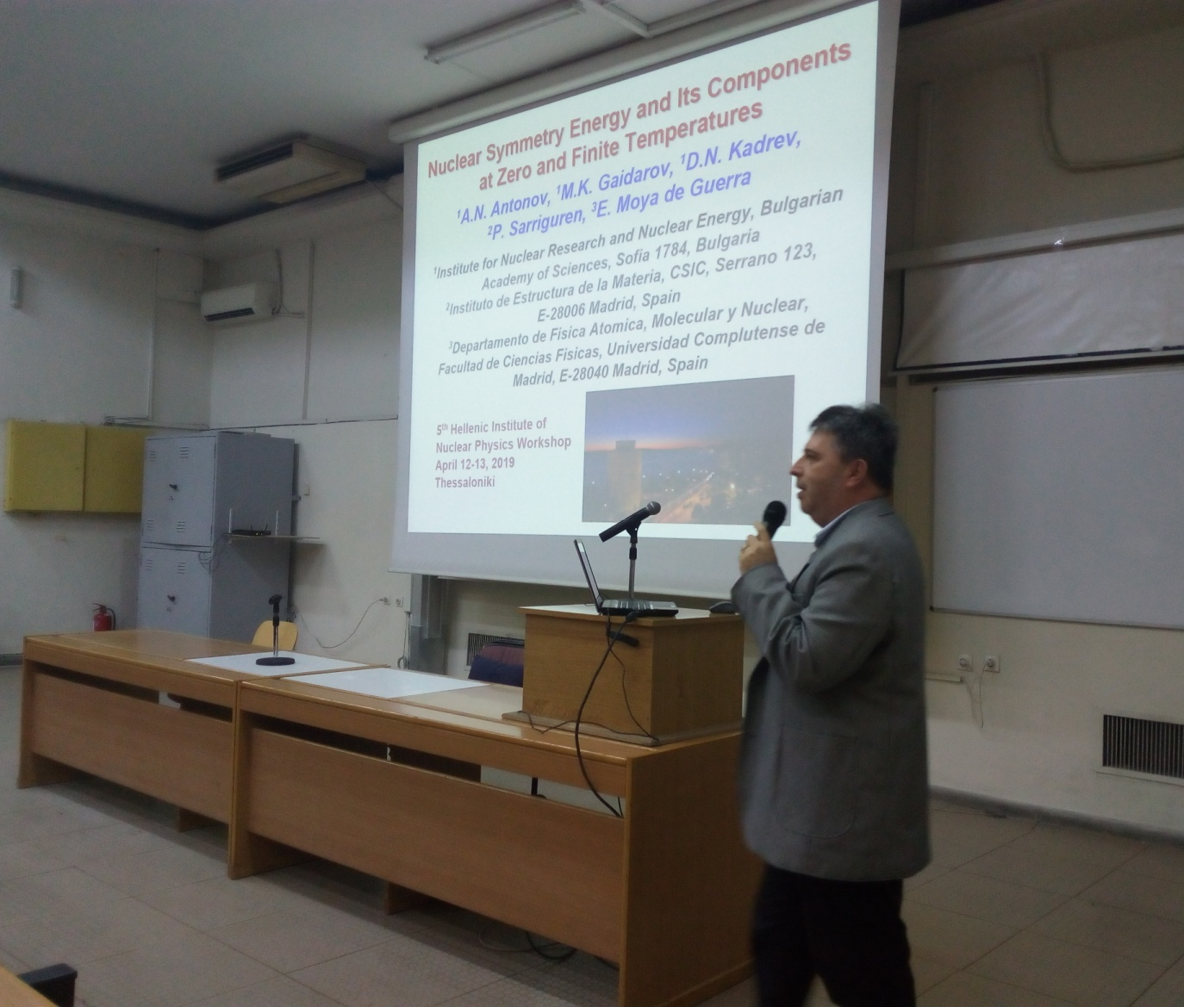
5th Hellenic Institute of Nuclear Physics Workshop (HINPw5)
April 12-13, 2019 - Physics Department, Aristotle University of Thessaloniki

Slide 21
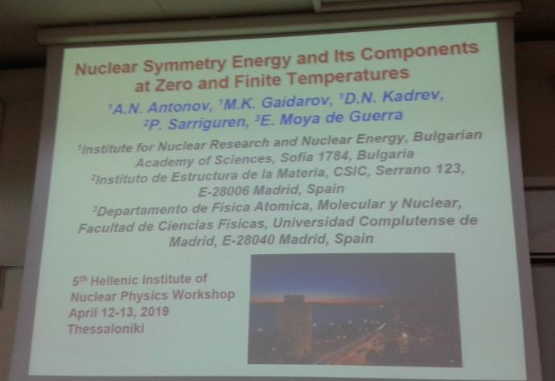
5th Hellenic Institute of Nuclear Physics Workshop (HINPw5)
April 12-13, 2019 - Physics Department, Aristotle University of Thessaloniki

Slide 22
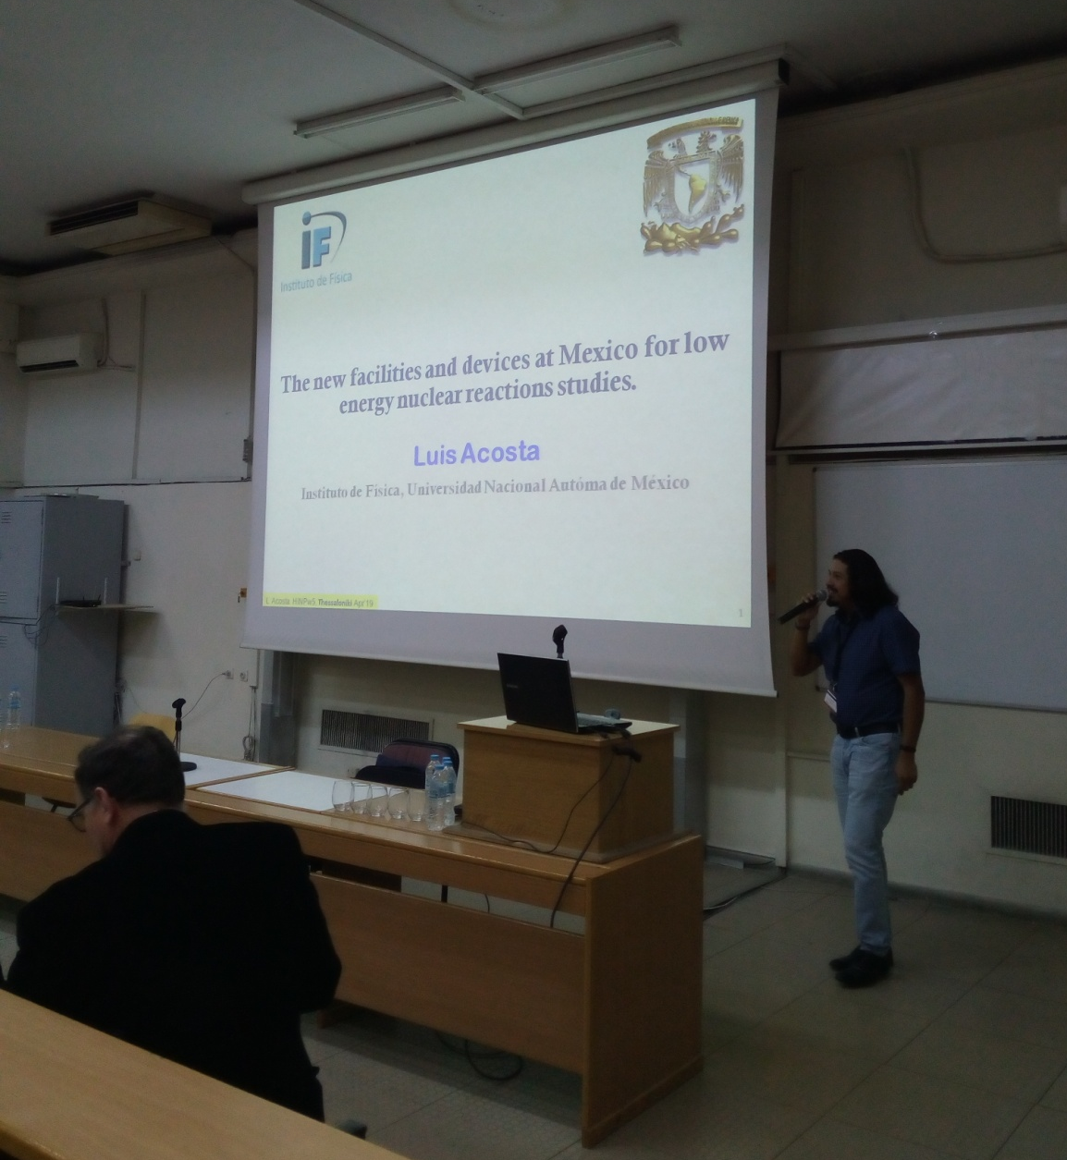
5th Hellenic Institute of Nuclear Physics Workshop (HINPw5)
April 12-13, 2019 - Physics Department, Aristotle University of Thessaloniki

Slide 23
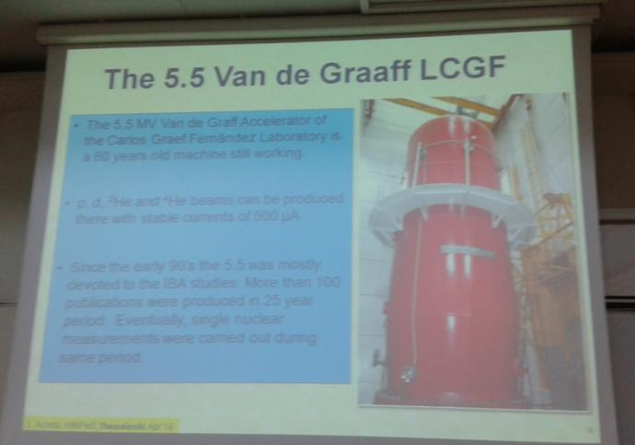
5th Hellenic Institute of Nuclear Physics Workshop (HINPw5)
April 12-13, 2019 - Physics Department, Aristotle University of Thessaloniki

Slide 24
5th Hellenic Institute of Nuclear Physics Workshop (HINPw5)
April 12-13, 2019 - Physics Department, Aristotle University of Thessaloniki

Slide 25
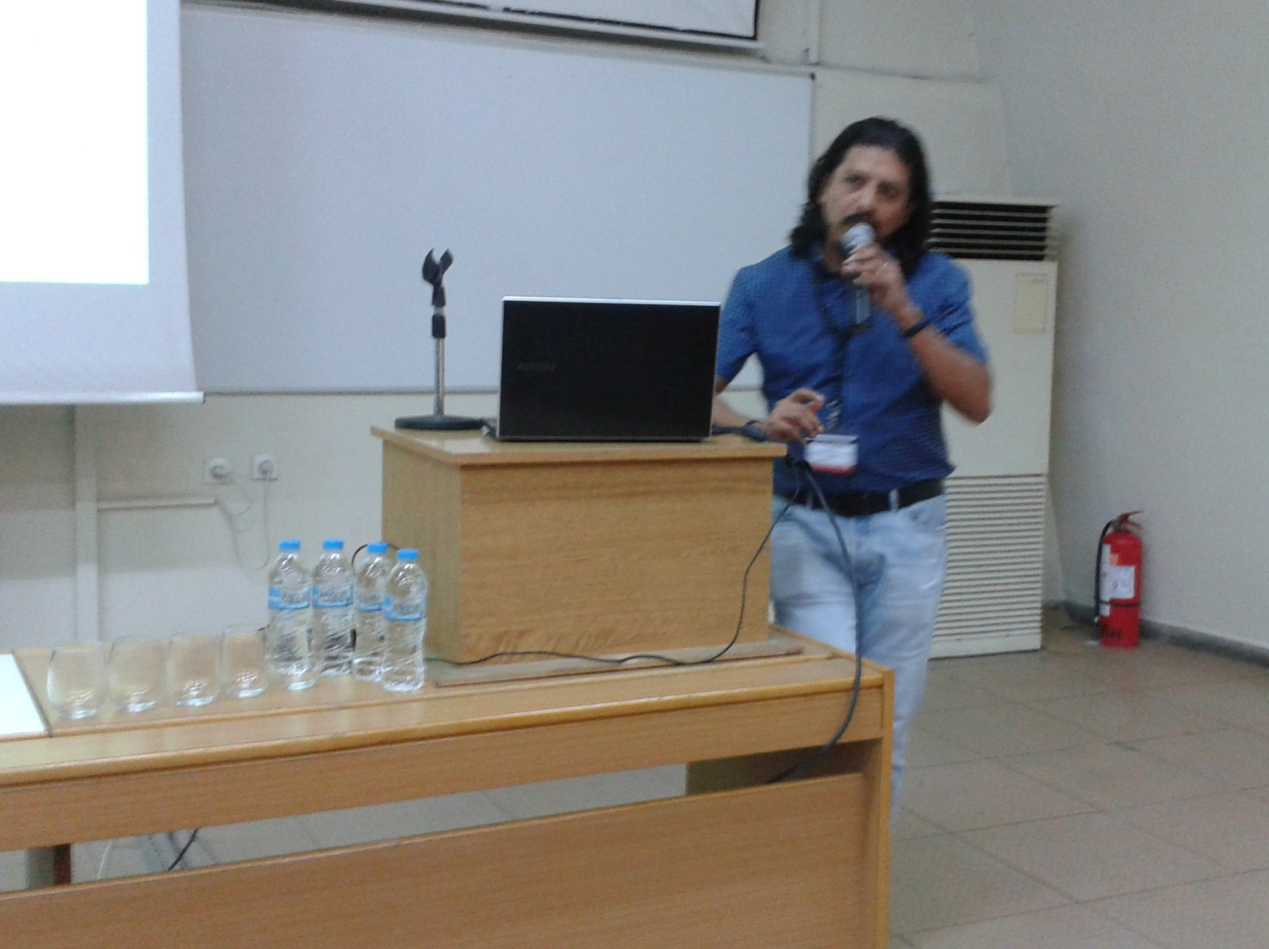
5th Hellenic Institute of Nuclear Physics Workshop (HINPw5)
April 12-13, 2019 - Physics Department, Aristotle University of Thessaloniki

Slide 26
5th Hellenic Institute of Nuclear Physics Workshop (HINPw5)
April 12-13, 2019 - Physics Department, Aristotle University of Thessaloniki

Slide 27
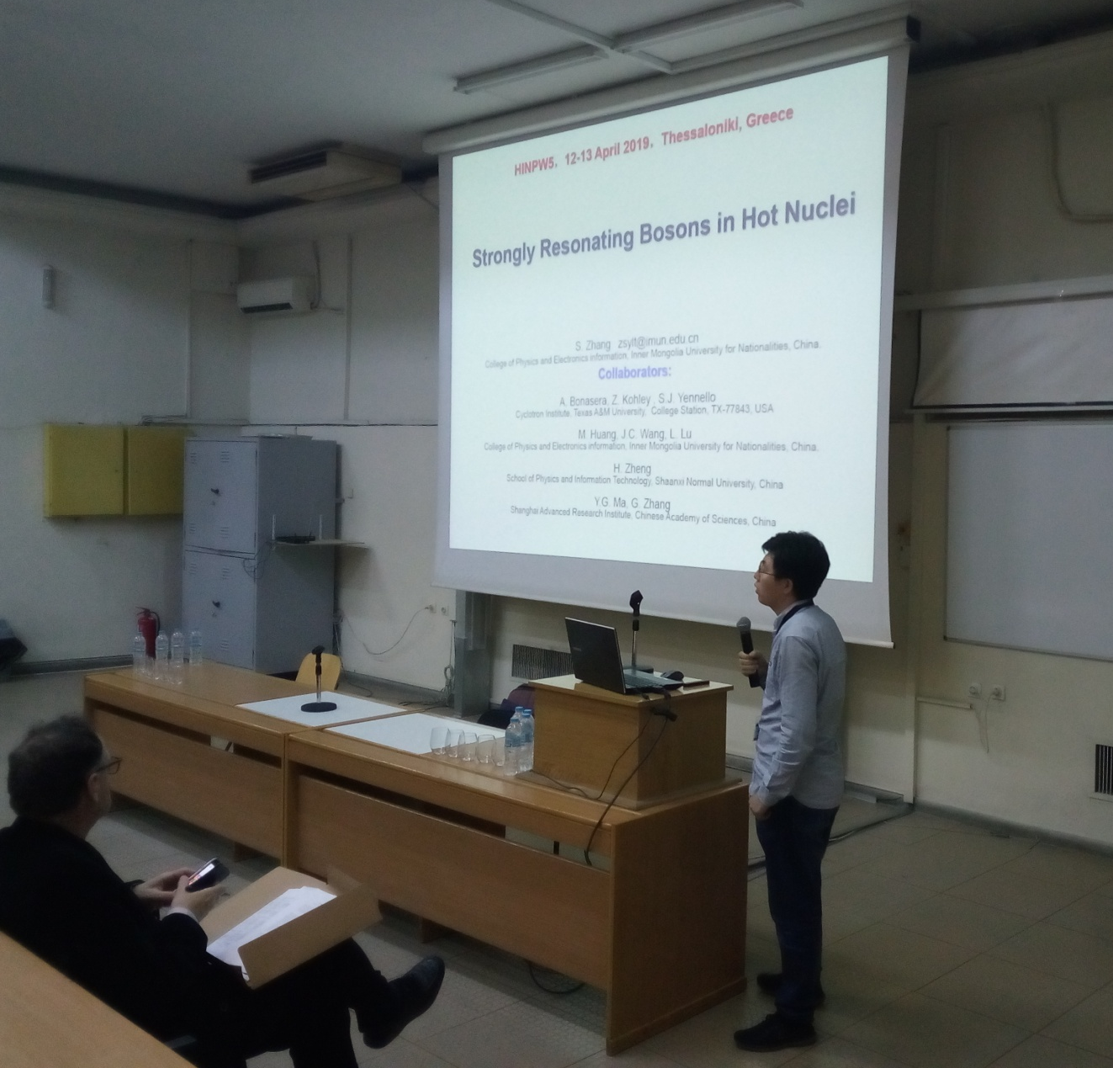
5th Hellenic Institute of Nuclear Physics Workshop (HINPw5)
April 12-13, 2019 - Physics Department, Aristotle University of Thessaloniki

Slide 28
5th Hellenic Institute of Nuclear Physics Workshop (HINPw5)
April 12-13, 2019 - Physics Department, Aristotle University of Thessaloniki

Slide 29
5th Hellenic Institute of Nuclear Physics Workshop (HINPw5)
April 12-13, 2019 - Physics Department, Aristotle University of Thessaloniki

Slide 30
5th Hellenic Institute of Nuclear Physics Workshop (HINPw5)
April 12-13, 2019 - Physics Department, Aristotle University of Thessaloniki

Slide 31
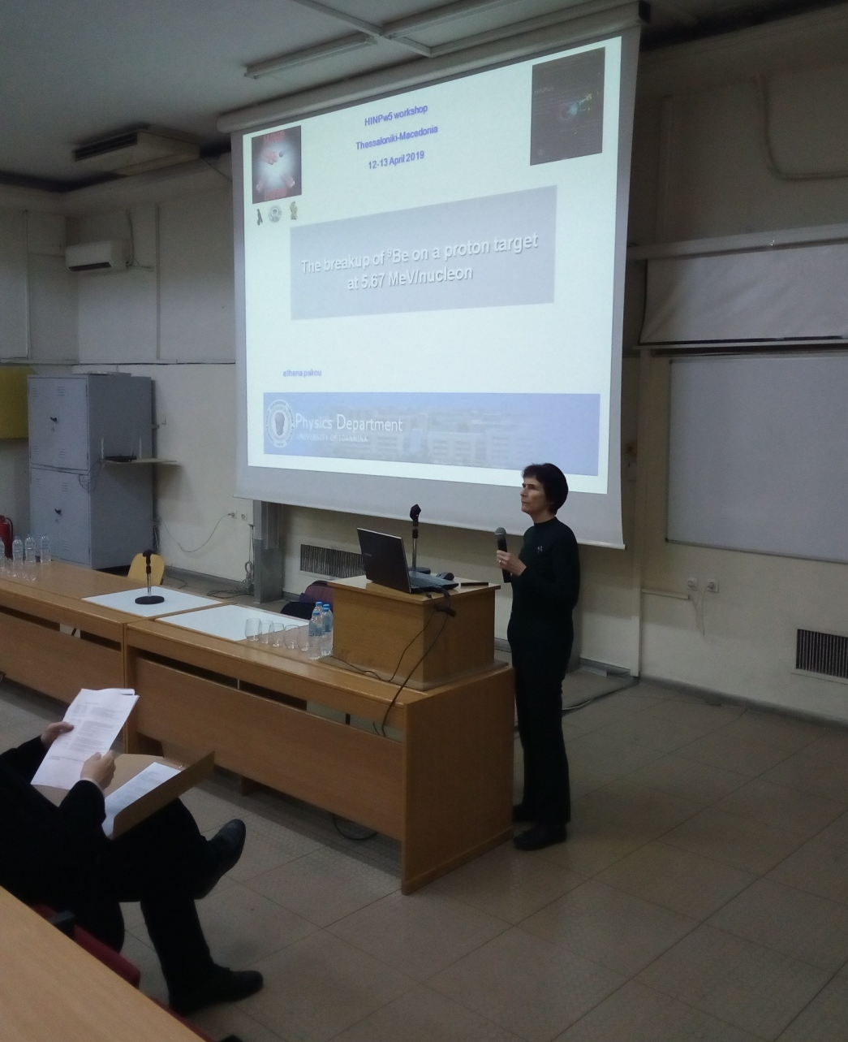
5th Hellenic Institute of Nuclear Physics Workshop (HINPw5)
April 12-13, 2019 - Physics Department, Aristotle University of Thessaloniki

Slide 32
5th Hellenic Institute of Nuclear Physics Workshop (HINPw5)
April 12-13, 2019 - Physics Department, Aristotle University of Thessaloniki

Slide 33
5th Hellenic Institute of Nuclear Physics Workshop (HINPw5)
April 12-13, 2019 - Physics Department, Aristotle University of Thessaloniki

Slide 34
5th Hellenic Institute of Nuclear Physics Workshop (HINPw5)
April 12-13, 2019 - Physics Department, Aristotle University of Thessaloniki

Slide 35
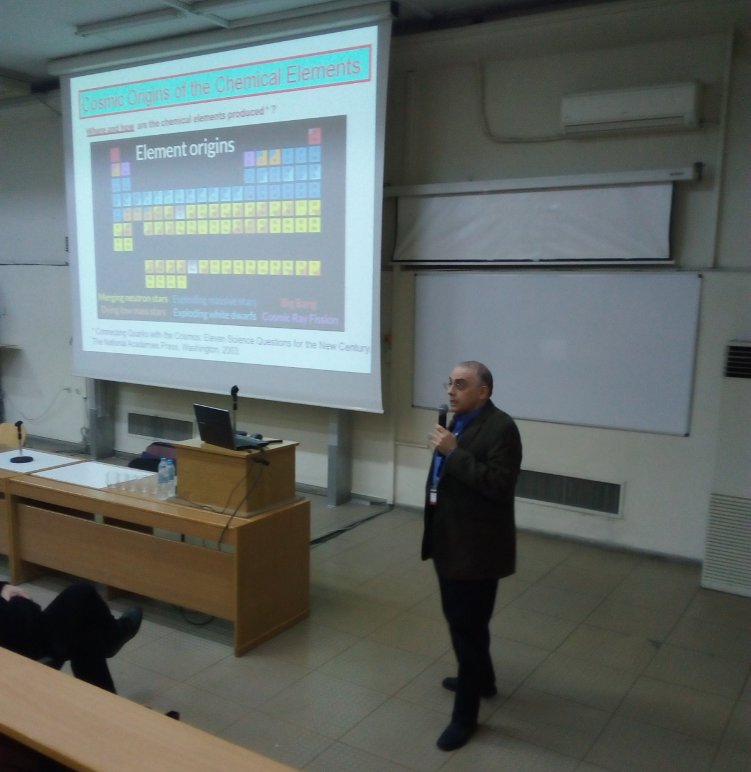
5th Hellenic Institute of Nuclear Physics Workshop (HINPw5)
April 12-13, 2019 - Physics Department, Aristotle University of Thessaloniki

Slide 36
5th Hellenic Institute of Nuclear Physics Workshop (HINPw5)
April 12-13, 2019 - Physics Department, Aristotle University of Thessaloniki

Slide 37
5th Hellenic Institute of Nuclear Physics Workshop (HINPw5)
April 12-13, 2019 - Physics Department, Aristotle University of Thessaloniki

Slide 38
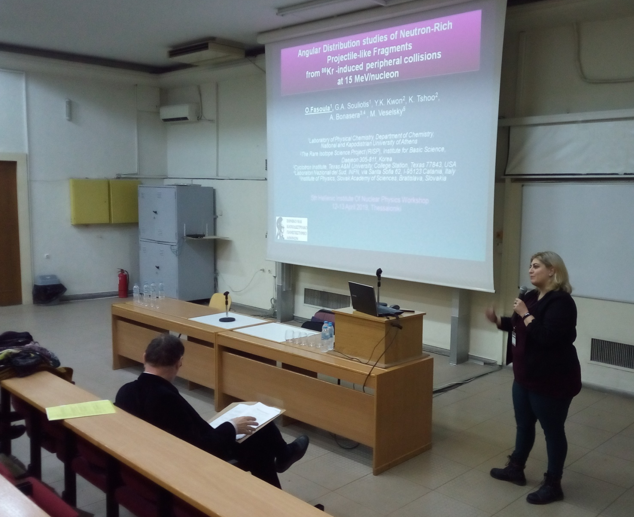
5th Hellenic Institute of Nuclear Physics Workshop (HINPw5)
April 12-13, 2019 - Physics Department, Aristotle University of Thessaloniki

Slide 39
5th Hellenic Institute of Nuclear Physics Workshop (HINPw5)
April 12-13, 2019 - Physics Department, Aristotle University of Thessaloniki

Slide 40
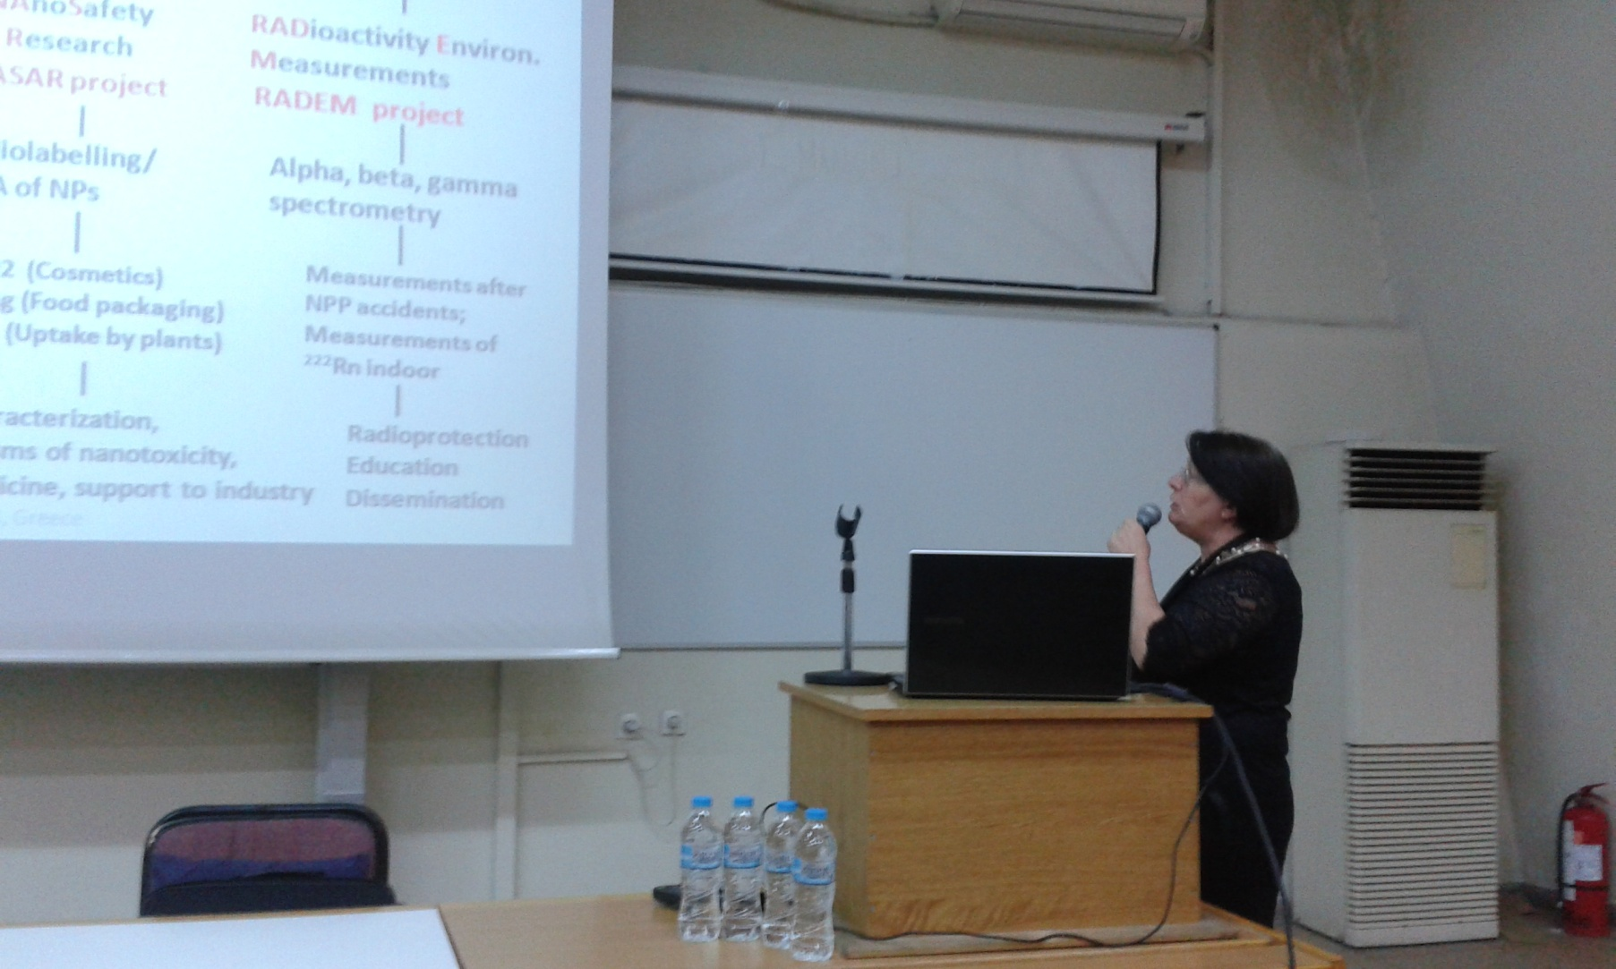
5th Hellenic Institute of Nuclear Physics Workshop (HINPw5)
April 12-13, 2019 - Physics Department, Aristotle University of Thessaloniki

Slide 41
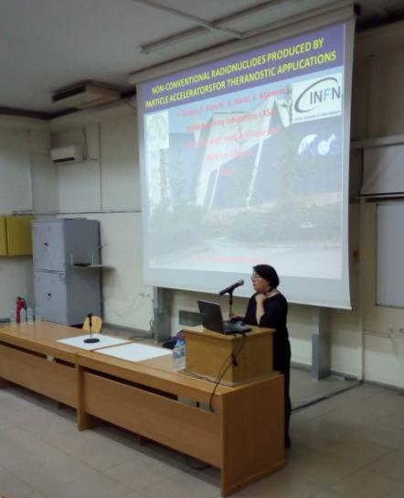
5th Hellenic Institute of Nuclear Physics Workshop (HINPw5)
April 12-13, 2019 - Physics Department, Aristotle University of Thessaloniki

Slide 42
5th Hellenic Institute of Nuclear Physics Workshop (HINPw5)
April 12-13, 2019 - Physics Department, Aristotle University of Thessaloniki

Slide 43
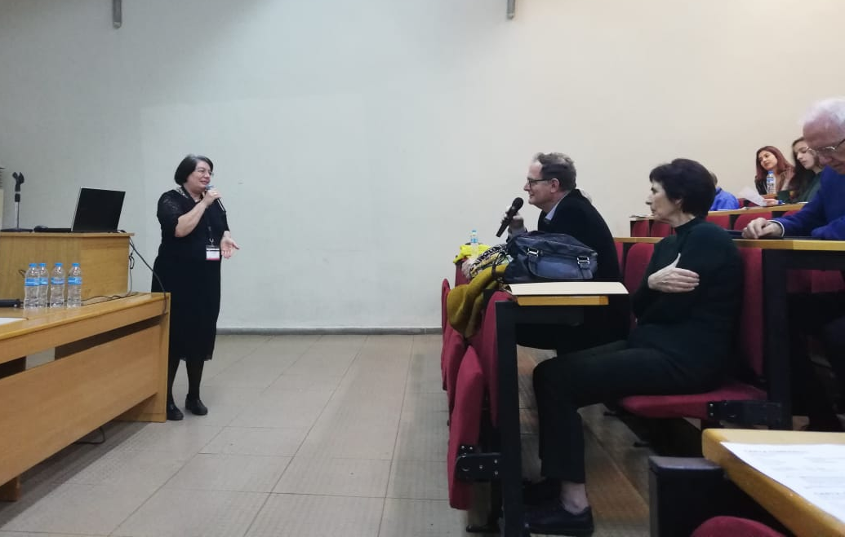
5th Hellenic Institute of Nuclear Physics Workshop (HINPw5)
April 12-13, 2019 - Physics Department, Aristotle University of Thessaloniki

Slide 44
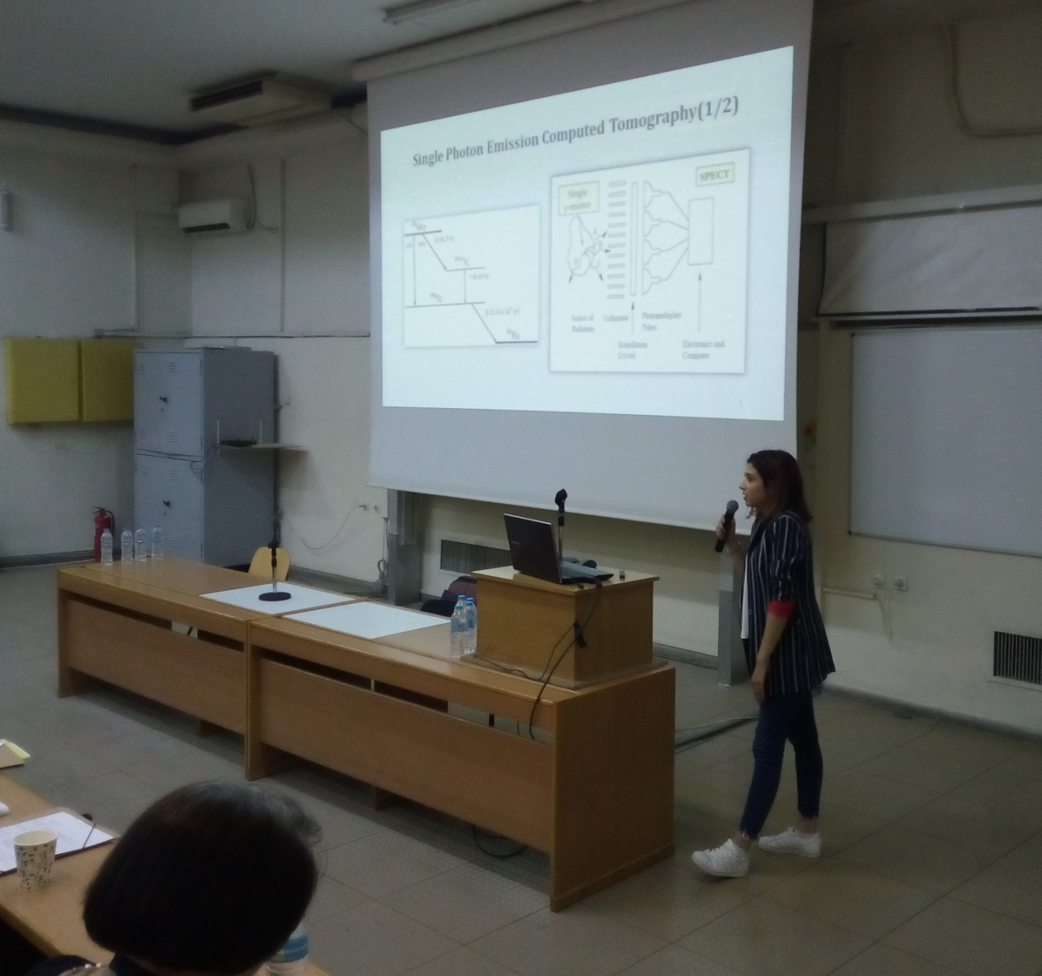
5th Hellenic Institute of Nuclear Physics Workshop (HINPw5)
April 12-13, 2019 - Physics Department, Aristotle University of Thessaloniki

Slide 45
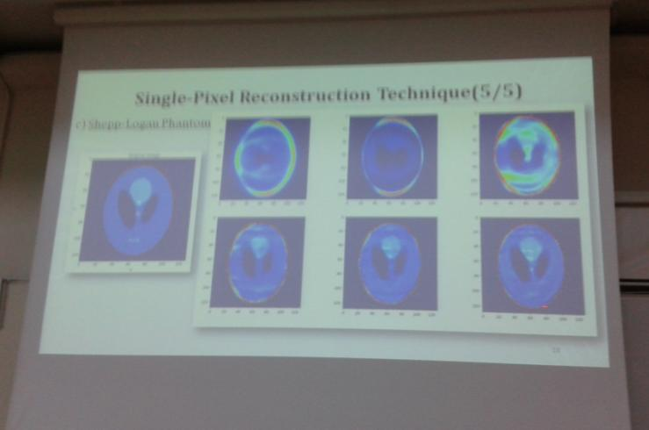
5th Hellenic Institute of Nuclear Physics Workshop (HINPw5)
April 12-13, 2019 - Physics Department, Aristotle University of Thessaloniki

Slide 46
5th Hellenic Institute of Nuclear Physics Workshop (HINPw5)
April 12-13, 2019 - Physics Department, Aristotle University of Thessaloniki

Slide 47
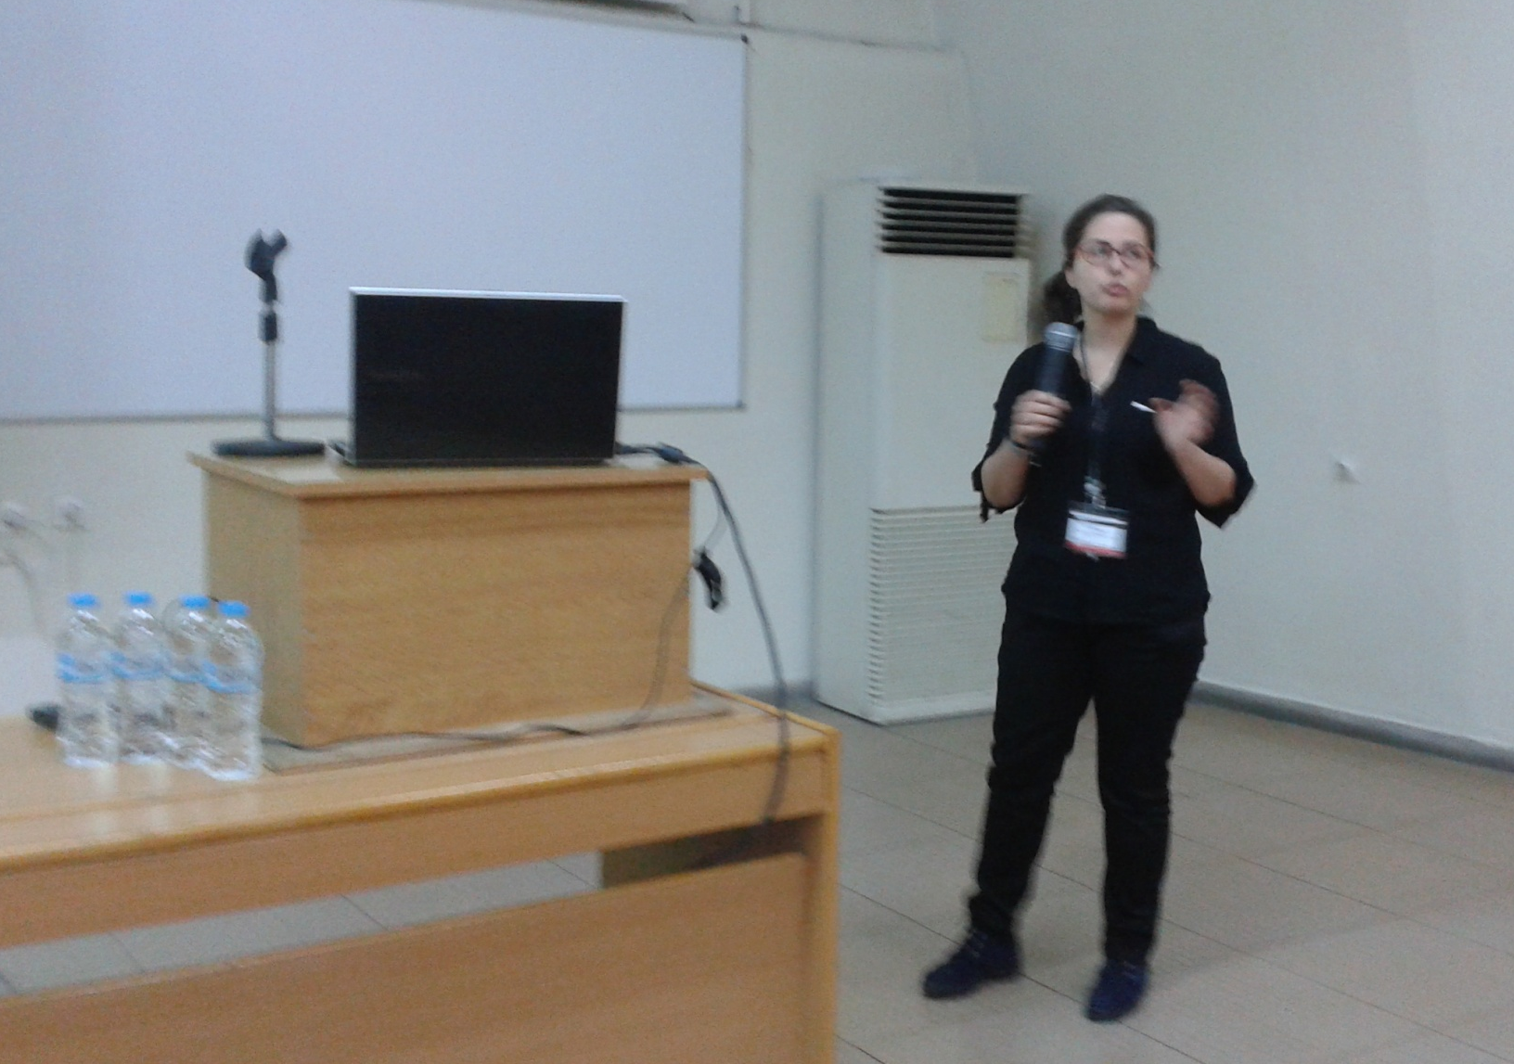
5th Hellenic Institute of Nuclear Physics Workshop (HINPw5)
April 12-13, 2019 - Physics Department, Aristotle University of Thessaloniki

Slide 48
5th Hellenic Institute of Nuclear Physics Workshop (HINPw5)
April 12-13, 2019 - Physics Department, Aristotle University of Thessaloniki

Slide 49
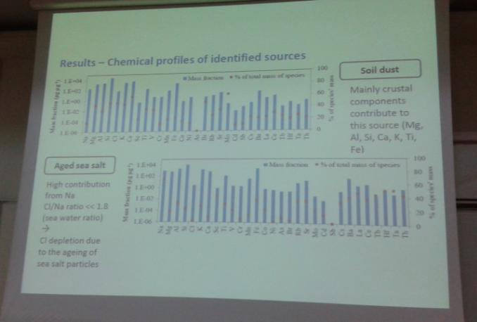
5th Hellenic Institute of Nuclear Physics Workshop (HINPw5)
April 12-13, 2019 - Physics Department, Aristotle University of Thessaloniki

Slide 50
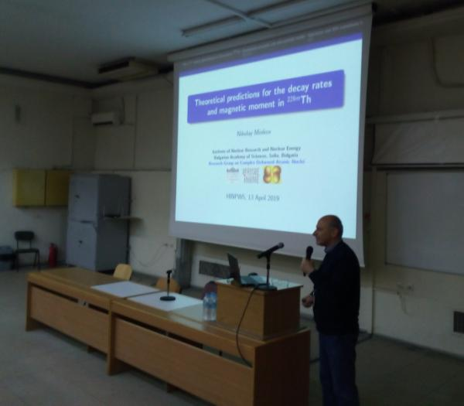
5th Hellenic Institute of Nuclear Physics Workshop (HINPw5)
April 12-13, 2019 - Physics Department, Aristotle University of Thessaloniki

Slide 51
5th Hellenic Institute of Nuclear Physics Workshop (HINPw5)
April 12-13, 2019 - Physics Department, Aristotle University of Thessaloniki

Slide 52
5th Hellenic Institute of Nuclear Physics Workshop (HINPw5)
April 12-13, 2019 - Physics Department, Aristotle University of Thessaloniki

Slide 53
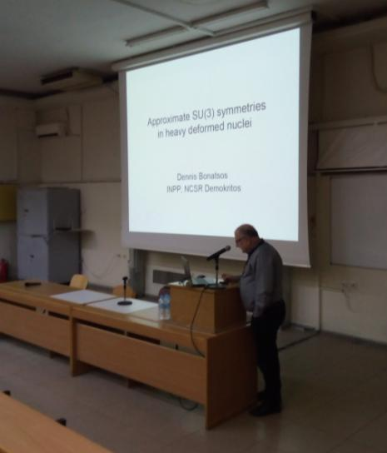
5th Hellenic Institute of Nuclear Physics Workshop (HINPw5)
April 12-13, 2019 - Physics Department, Aristotle University of Thessaloniki

Slide 54
5th Hellenic Institute of Nuclear Physics Workshop (HINPw5)
April 12-13, 2019 - Physics Department, Aristotle University of Thessaloniki

Slide 55
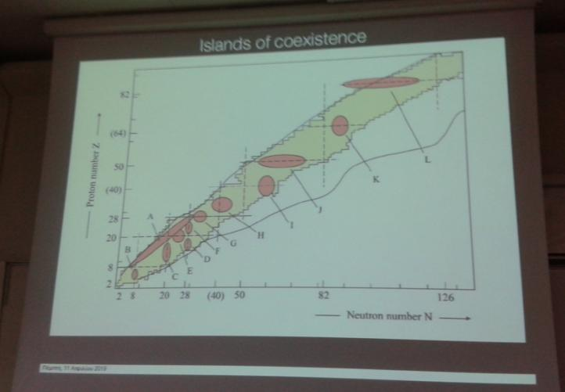
5th Hellenic Institute of Nuclear Physics Workshop (HINPw5)
April 12-13, 2019 - Physics Department, Aristotle University of Thessaloniki

Slide 56
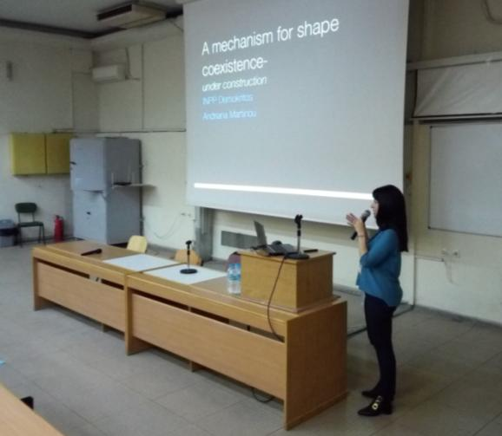
5th Hellenic Institute of Nuclear Physics Workshop (HINPw5)
April 12-13, 2019 - Physics Department, Aristotle University of Thessaloniki

Slide 57
5th Hellenic Institute of Nuclear Physics Workshop (HINPw5)
April 12-13, 2019 - Physics Department, Aristotle University of Thessaloniki

Slide 58
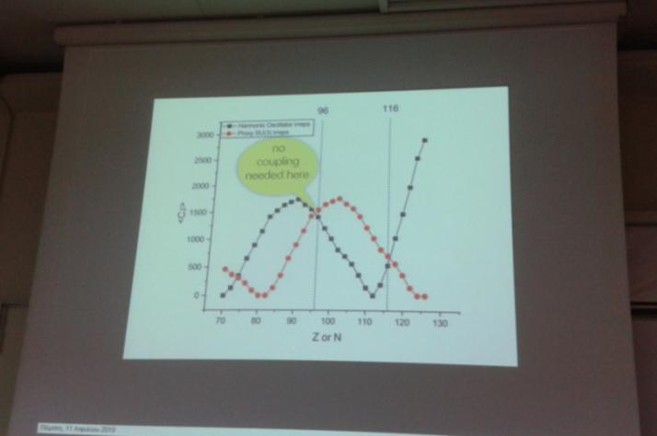
5th Hellenic Institute of Nuclear Physics Workshop (HINPw5)
April 12-13, 2019 - Physics Department, Aristotle University of Thessaloniki

Slide 59
5th Hellenic Institute of Nuclear Physics Workshop (HINPw5)
April 12-13, 2019 - Physics Department, Aristotle University of Thessaloniki

Slide 60
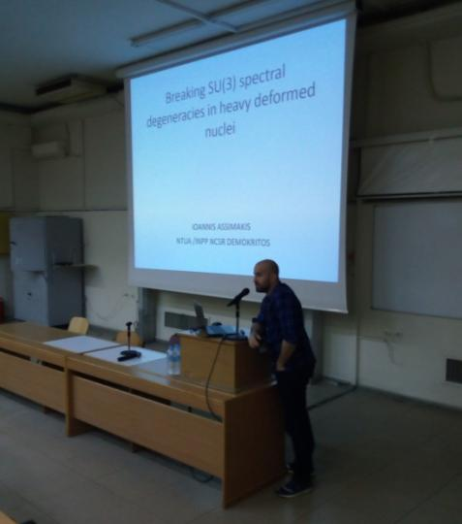
5th Hellenic Institute of Nuclear Physics Workshop (HINPw5)
April 12-13, 2019 - Physics Department, Aristotle University of Thessaloniki

Slide 61
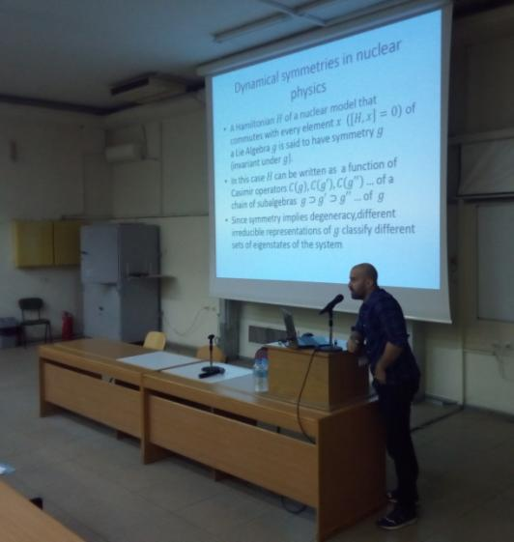
5th Hellenic Institute of Nuclear Physics Workshop (HINPw5)
April 12-13, 2019 - Physics Department, Aristotle University of Thessaloniki

Slide 62
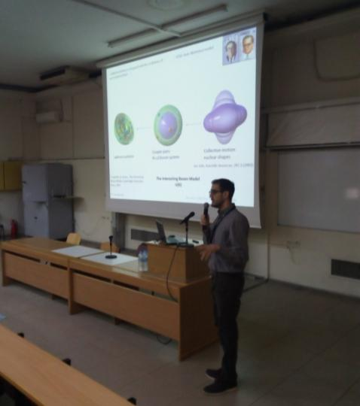
5th Hellenic Institute of Nuclear Physics Workshop (HINPw5)
April 12-13, 2019 - Physics Department, Aristotle University of Thessaloniki

Slide 63
5th Hellenic Institute of Nuclear Physics Workshop (HINPw5)
April 12-13, 2019 - Physics Department, Aristotle University of Thessaloniki

Slide 64
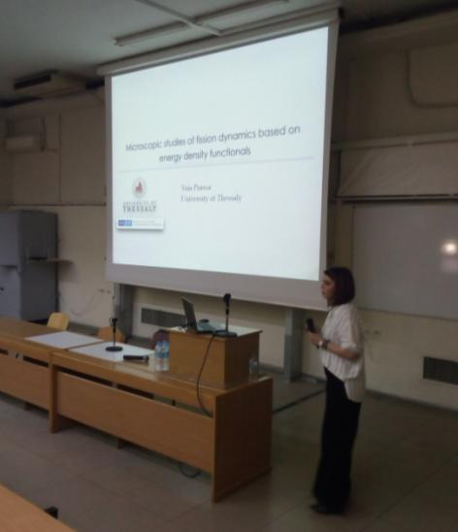
5th Hellenic Institute of Nuclear Physics Workshop (HINPw5)
April 12-13, 2019 - Physics Department, Aristotle University of Thessaloniki

Slide 65
5th Hellenic Institute of Nuclear Physics Workshop (HINPw5)
April 12-13, 2019 - Physics Department, Aristotle University of Thessaloniki

Slide 66
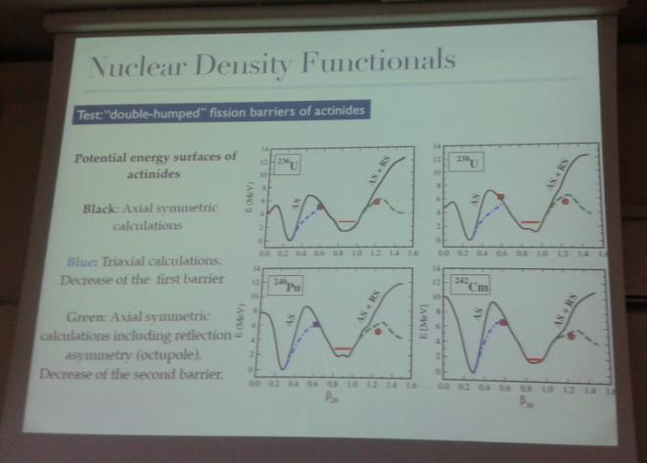
5th Hellenic Institute of Nuclear Physics Workshop (HINPw5)
April 12-13, 2019 - Physics Department, Aristotle University of Thessaloniki

Slide 67
5th Hellenic Institute of Nuclear Physics Workshop (HINPw5)
April 12-13, 2019 - Physics Department, Aristotle University of Thessaloniki

Slide 68
5th Hellenic Institute of Nuclear Physics Workshop (HINPw5)
April 12-13, 2019 - Physics Department, Aristotle University of Thessaloniki

Slide 69
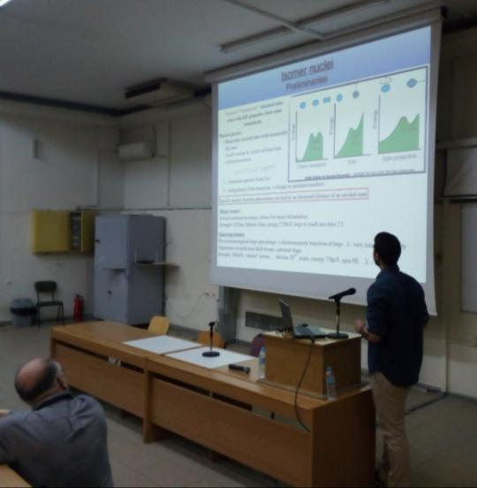
5th Hellenic Institute of Nuclear Physics Workshop (HINPw5)
April 12-13, 2019 - Physics Department, Aristotle University of Thessaloniki

Slide 70
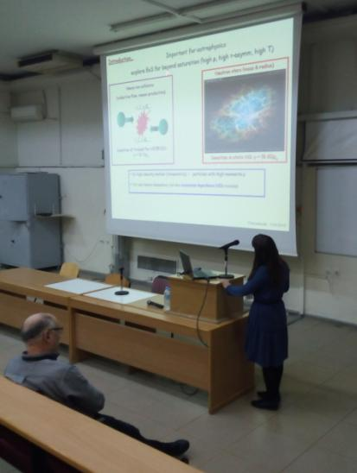
5th Hellenic Institute of Nuclear Physics Workshop (HINPw5)
April 12-13, 2019 - Physics Department, Aristotle University of Thessaloniki

Slide 71
5th Hellenic Institute of Nuclear Physics Workshop (HINPw5)
April 12-13, 2019 - Physics Department, Aristotle University of Thessaloniki

Slide 72
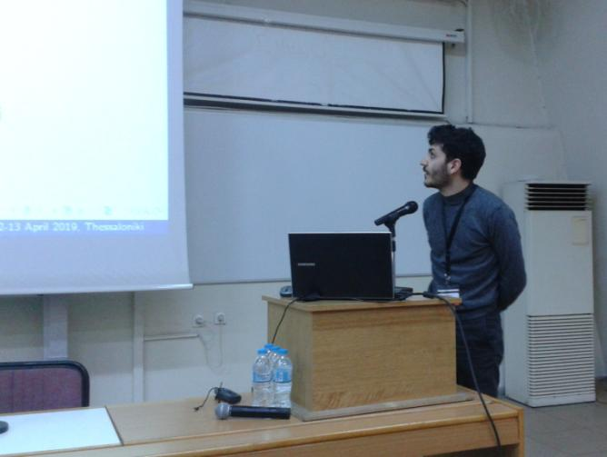
5th Hellenic Institute of Nuclear Physics Workshop (HINPw5)
April 12-13, 2019 - Physics Department, Aristotle University of Thessaloniki

Slide 73
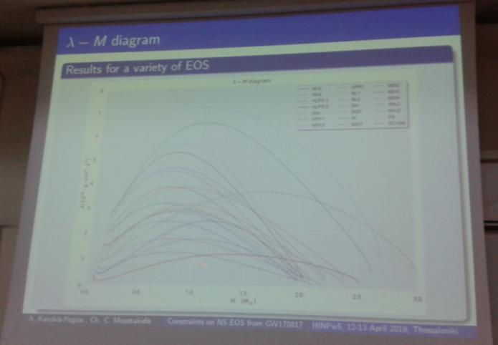
5th Hellenic Institute of Nuclear Physics Workshop (HINPw5)
April 12-13, 2019 - Physics Department, Aristotle University of Thessaloniki

Slide 74
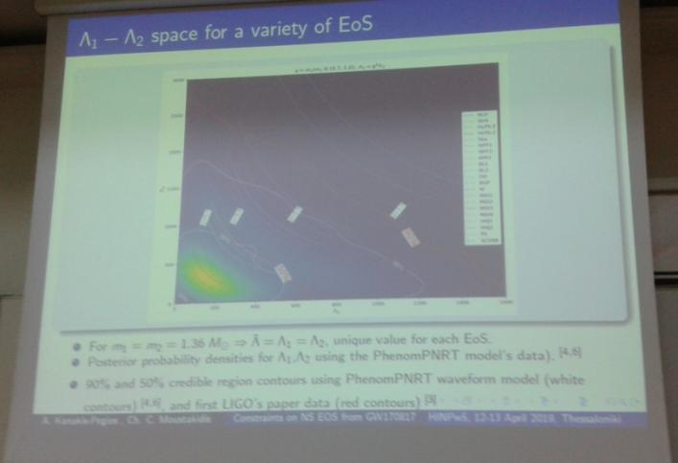
5th Hellenic Institute of Nuclear Physics Workshop (HINPw5)
April 12-13, 2019 - Physics Department, Aristotle University of Thessaloniki

Slide 75
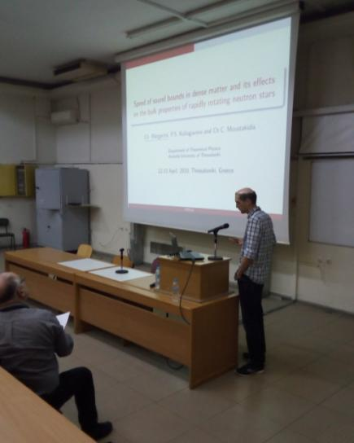
5th Hellenic Institute of Nuclear Physics Workshop (HINPw5)
April 12-13, 2019 - Physics Department, Aristotle University of Thessaloniki

Slide 76
5th Hellenic Institute of Nuclear Physics Workshop (HINPw5)
April 12-13, 2019 - Physics Department, Aristotle University of Thessaloniki

